Slide 1
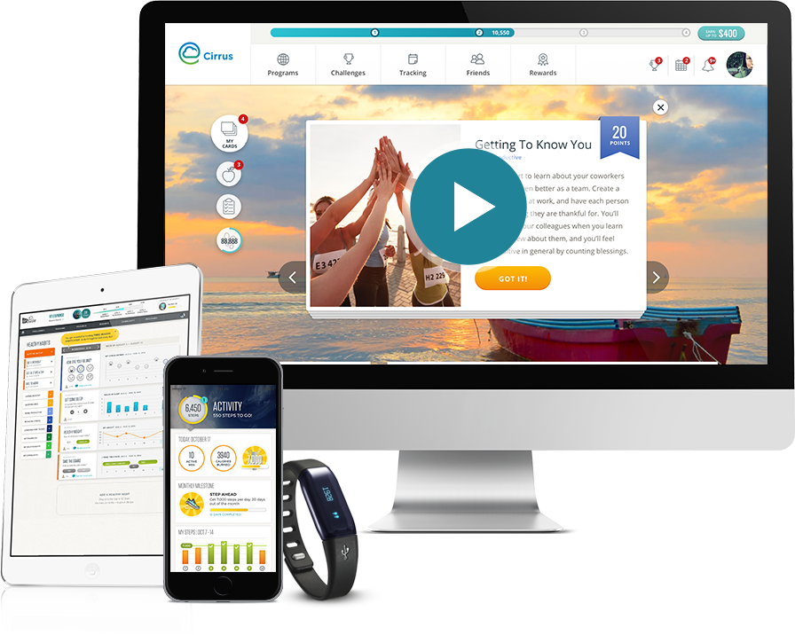
Welcome to your well-being program

Slide 2
Blue Cross & Blue Shield of Rhode Island brings you an effective and enjoyable program, powered by Virgin Pulse®. The more you engage with it, the better you can feel, and the more you’ll be rewarded!
*This program is available to Blue Cross & Blue Shield of Rhode Island members only.

Slide 3
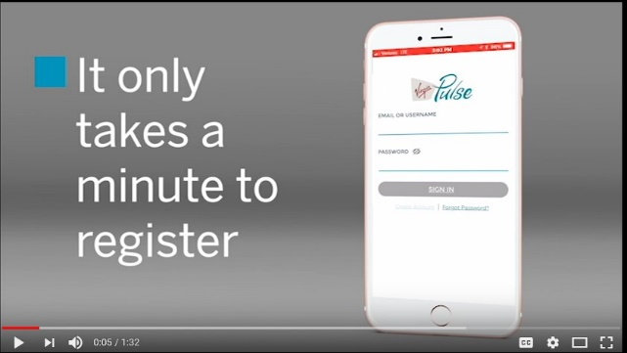
3 simple steps to get started!
1. Sign up – Go to join.VirginPulse.com or download the app** to get started. 2. Choose Blue Cross & Blue Shield of Rhode Island as your sponsor. 3. Connect your Fitbit® or other wearable device to track and sync steps with the app.
Watch this video to see how simple!
** Apple and the Apple logo are trademarks of Apple Inc., registered in the U.S. and other countries. App Store is a service mark of Apple Inc.
Android & Google Play is a trademark of Google Inc.

Slide 4
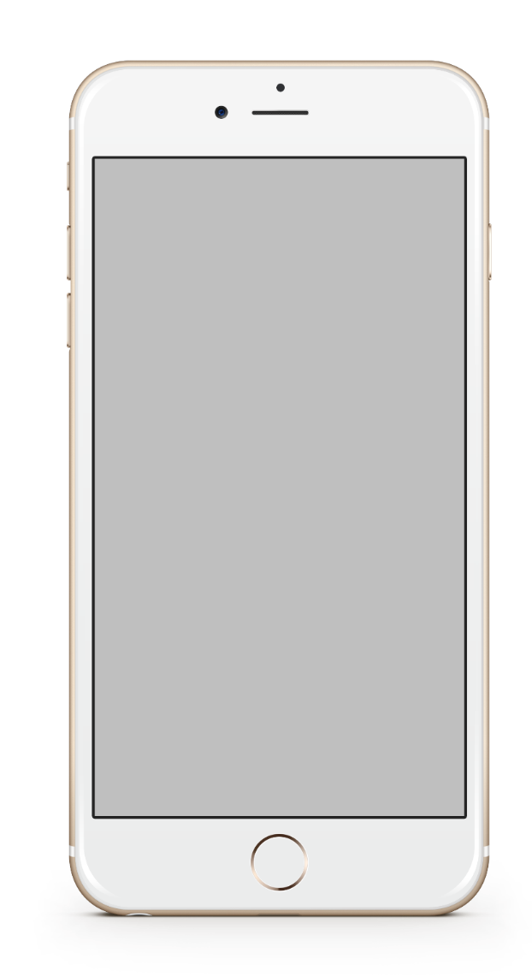
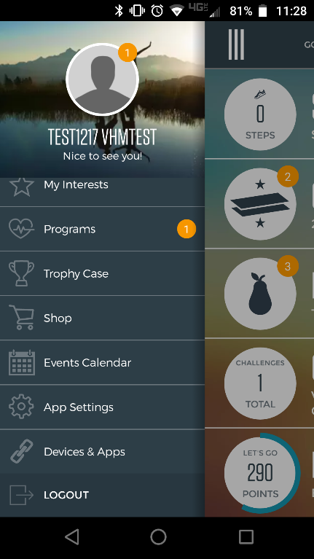
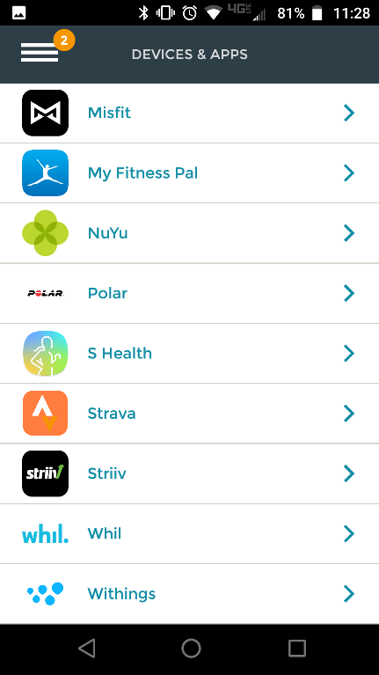
Sync a device to get tracking
Tap Devices & Apps
Sync your Fitbit, other wearable device, or even your iPhone to track and sync steps with the app.

Slide 5
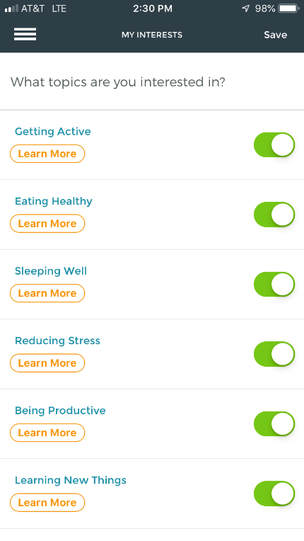
Customize your interests
Tap My Interests
Choose as many interests as you like —from sleeping well and reducing stress to increas­ing productivity and more—all to help you personalize your well-being program.

Slide 6
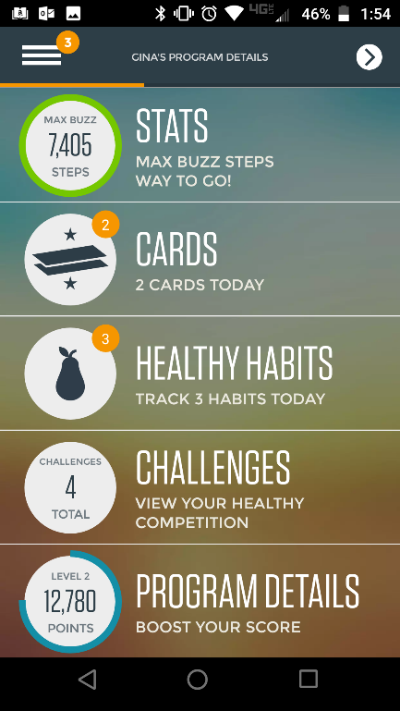
Use your Home screen to check-in
Daily Cards
Challenges
There are new cards every day.
Start a challenge or join a team challenge.
Healthy Habits
Program Details
You get rewarded for tracking three healthy habits each day
Check your progress and find ways to boost your score.

Slide 7
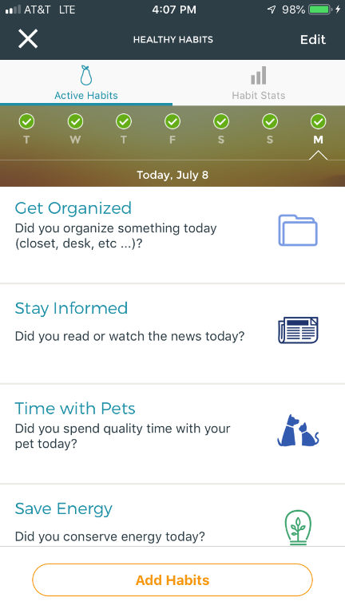
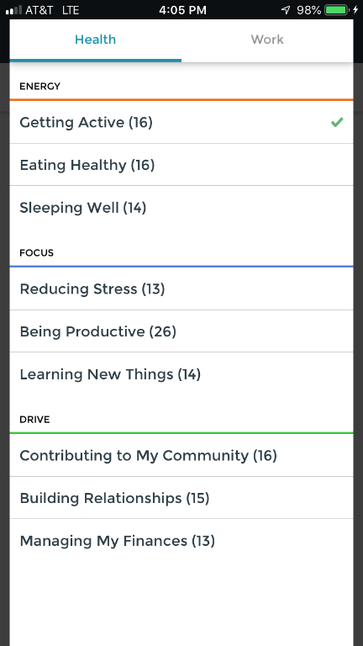
Track your Healthy Habits
Tap Healthy Habits
Choose which habits you’d like to build and be sure you track them. You get rewarded for tracking three healthy habits each day.

Slide 8
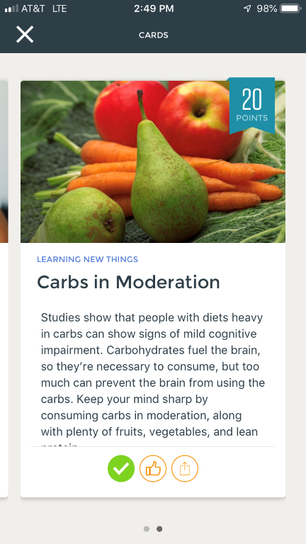
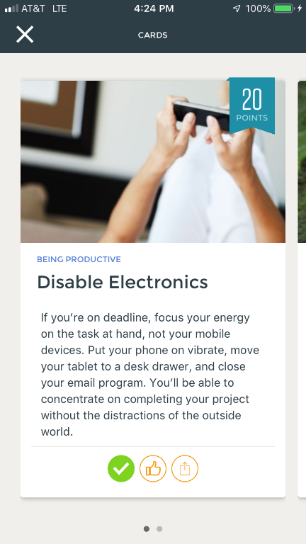
Review your Daily Cards
Tap Daily Cards
To earn points, complete the cards. There are new cards on the site and the app every day.

Slide 9
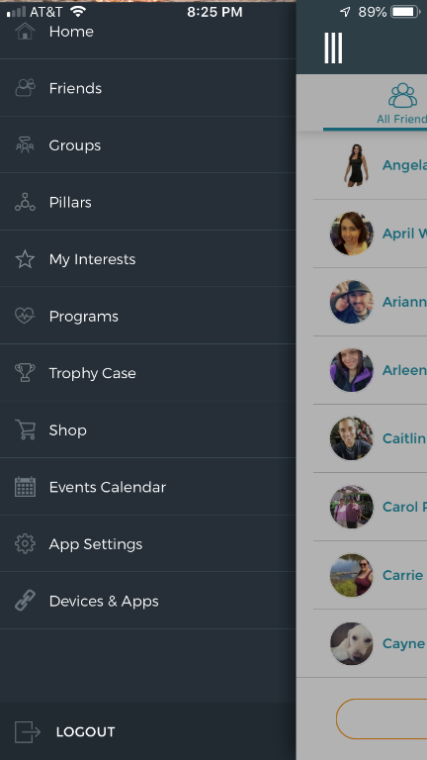
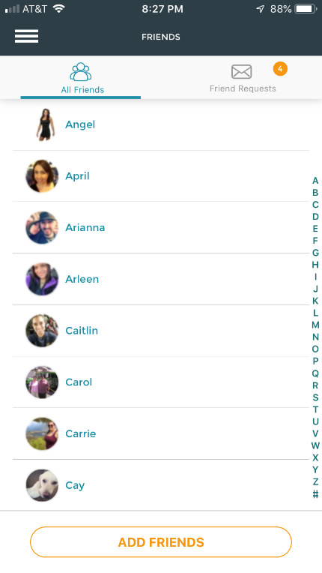
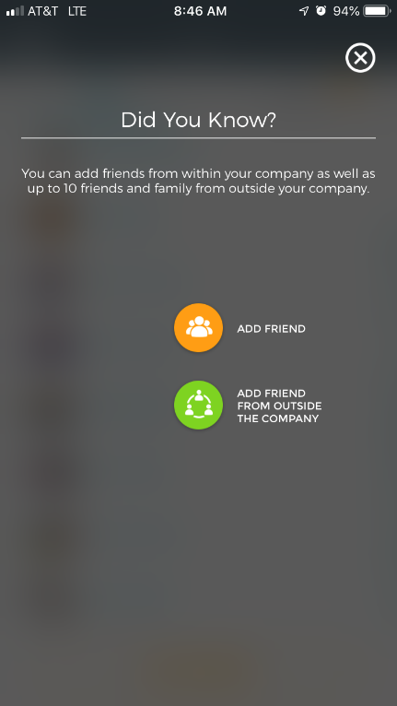
Invite friends
Tap Friends
Bring friends and family into the program! Earn points when you add them, and then create groups around common interests, like biking, cooking, or walking.

Slide 10
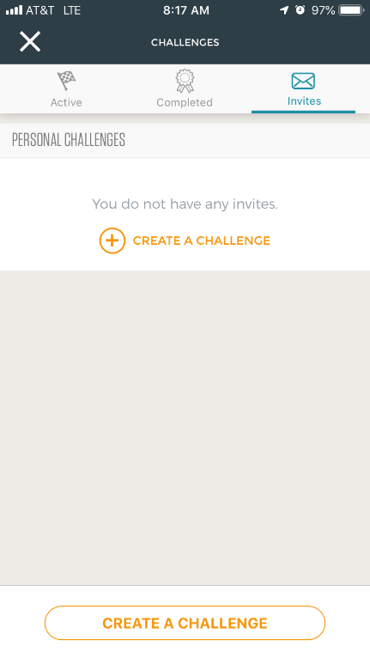
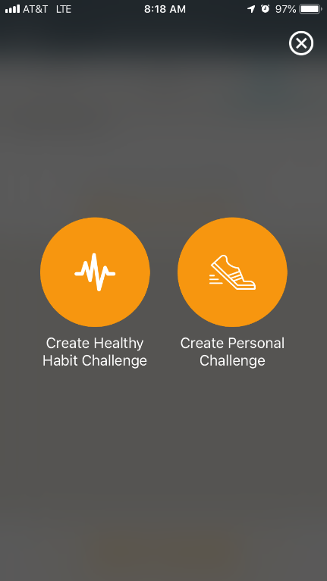
Start a Challenge
Tap Challenges
Start a challenge or join a team challenge to increase your steps and potentially earn points by going head-to-head with your friends.

Slide 11
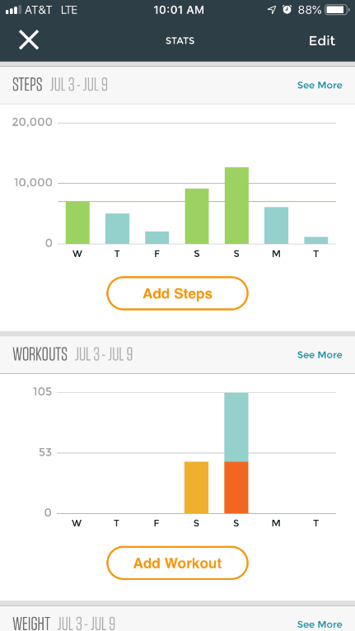
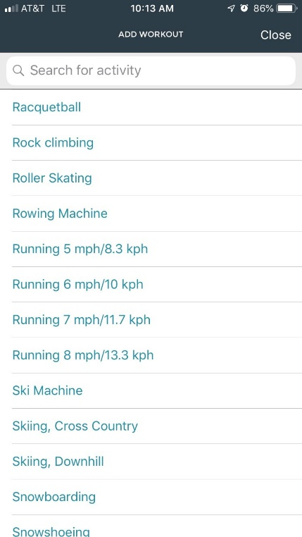
Check your Stats
Tap Stats
Check your progress to see the steps you’ve taken, the calories you’ve consumed, sleep data, and other measurements. You can even add a work out.

Slide 12
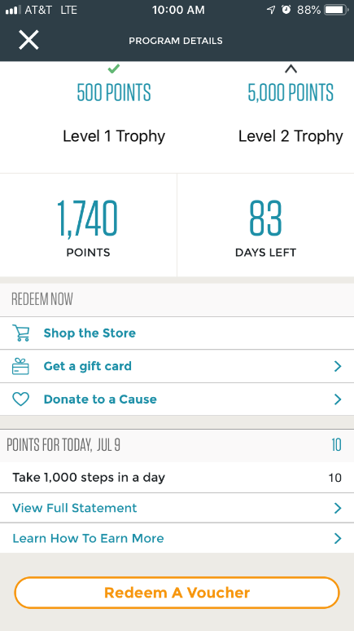
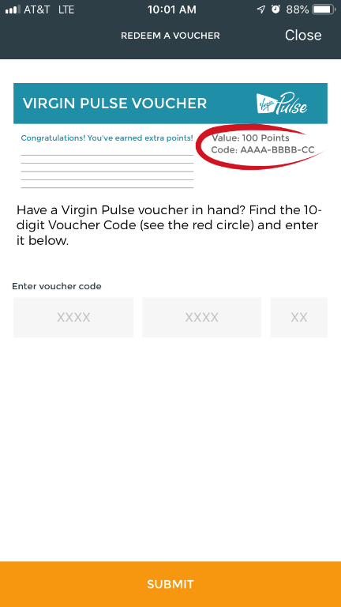
View your Program Details
Tap Program Details
Check your progress for the quarter. You can also redeem a voucher that you may receive for participating in special activities.

Slide 13
500 Exchange Street • Providence, RI 02903-2699
Blue Cross & Blue Shield of Rhode Island is an independent licensee of the Blue Cross and Blue Shield Association. Virgin Pulse® is an independent wellness company, contracted by Blue Cross & Blue Shield of Rhode Island to provide wellness services.
07/19 ANC-339142

